Slide 1
Machine Learning
Unit – 3 – [Part 3]
Non-Parametric Methods

Slide 2
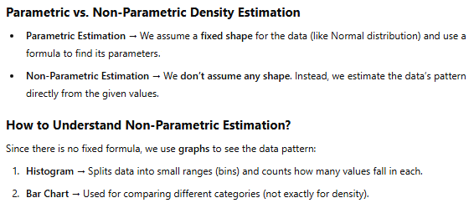
Non-Parametric Density Estimation

Slide 3

Another question arises: We can use histograms and bar charts in parametric estimation as well. .

Slide 4
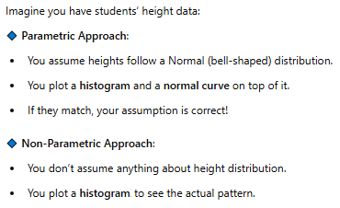

Slide 5
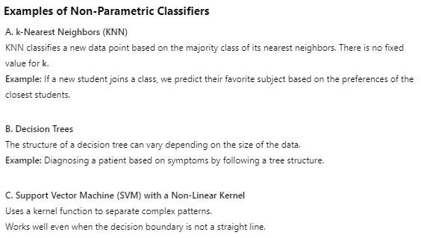
Non-Parametric Classification

Slide 6
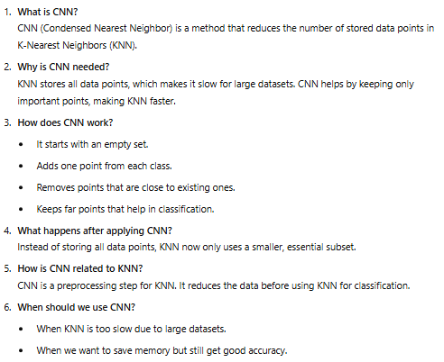
Condensed Nearest Neighbor

Slide 7
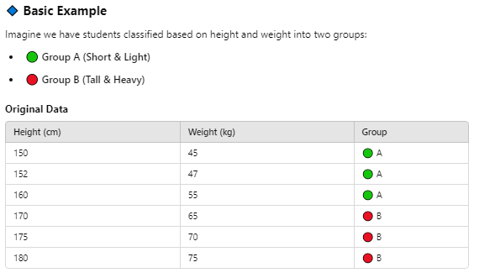

Slide 8
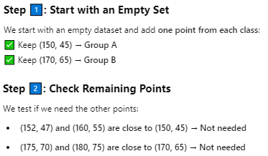


Slide 9



Slide 10
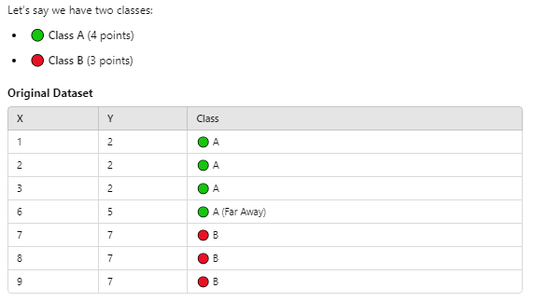

Slide 11
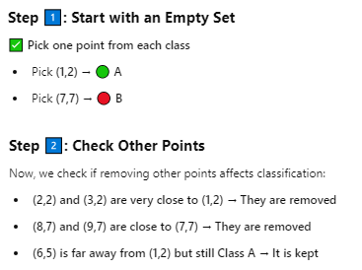

Slide 12




